Slide 1
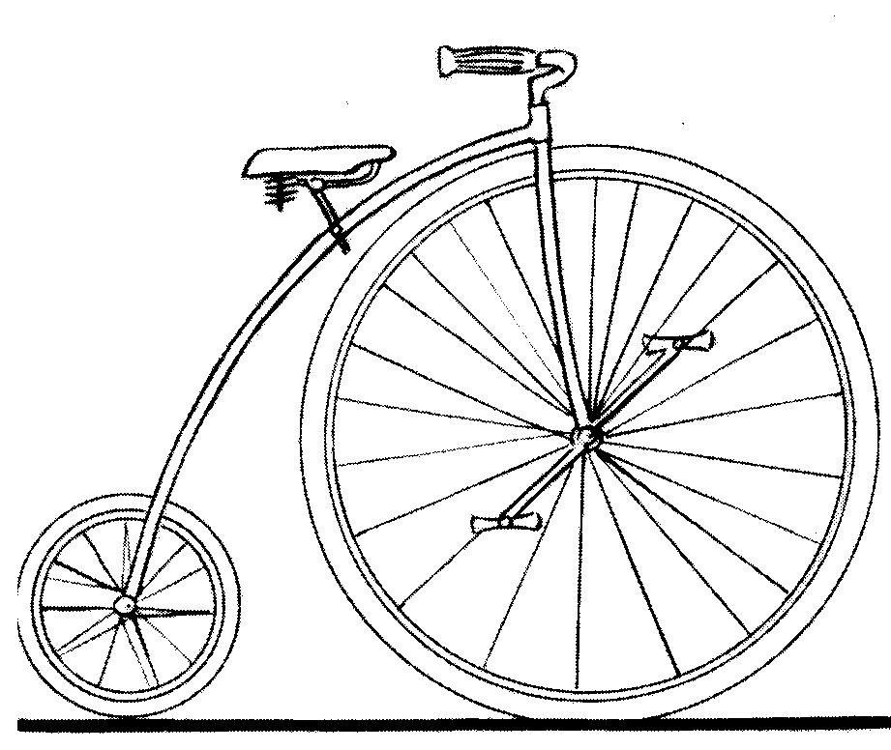
Cycling to success: Academic libraries and the research and learning cycle
Cathrine Harboe-Ree
University Librarian, Monash University
University of Hong Kong Libraries Centenary Conference,
8 November 2012

Slide 2
Monash University
Established 1958
10 faculties on six Australian campuses, plus Malaysia, South Africa
Centre in Prato, Italy
63,000 students from more than 100 countries
73% UG 20% GPG 7% HDR
10.6% off campus 35% international students
3,500 academic staff (7,700 total staff)
Total research income $282.5 m (2011)
Partnerships in Hong Kong, Singapore, China, India…
Current world rankings
ARWU: Top 150 (best in Australia in some categories)
THES: 99th

Slide 3
“While predictions of radical change in library and information services are by no means new, a confluence of shifts in technology, changing user demands and increasing budget pressures are now forcing academic libraries to either adapt or risk obsolescence.”
Redefining the academic library
The Advisory Board Company, 2011

Slide 4
Obtaining funding
Citation information
Research data management plans
Bibliographies
Plan and design
Literature search
Obtaining scholarly information
Managing references
Skills development
Undertaking research
Research data management
Collaboration: ANDS
Archiving and preserving
Research data management
Repository
Metadata
Teaching-research nexus
Literature search
Skills development
Publishing
Repository
Dissemination
Publishing
Open access repository
Copyright
ANDS

Slide 5
Contributing to success
Research data management
Monash University Research Repository
Australian National Data Service
Monash University Publishing
Research skills development

Slide 6
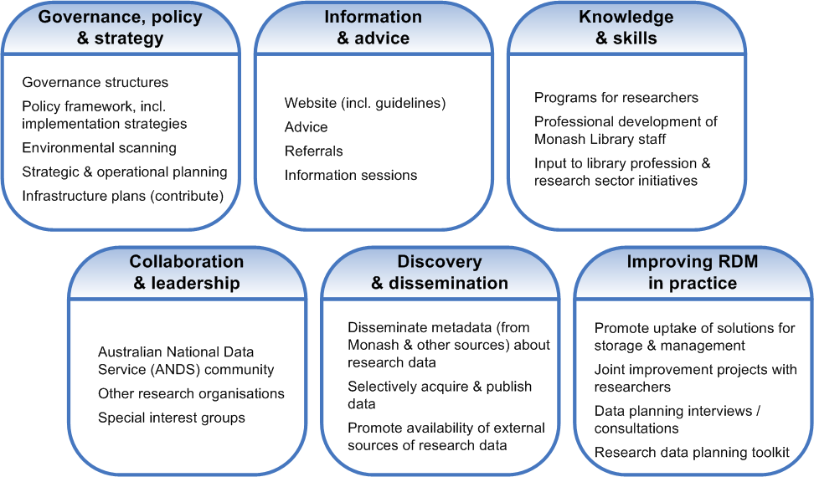
Research data management

Slide 7
Monash Research Repository
78,570 items
Publications required for Excellence in Research Australia (ERA)
Journal collections
Research data
Journal collections
Newspapers
Monash University Patents Collection
PhD Doctorate theses
Faculty of Business and Economics working papers

Slide 8
Research data and the Repository
Protein crystallography
Kartomi Collection of Traditional Musical Arts in Sumatra
Kashgar project: Gollings Collection
Notes:
Collections
Datasets
The ARROW Repository is experimenting with the storage and publication of instrument datasets to support conventional research publications. The first dataset published is
2QP2 - Structure of a MACPF/Perforin-like protein. (http://arrow.monash.edu.au/hdl/1959.1/5863)
Information on experimental dataset object “monash:5863”
Dataset consists of 5 experiments on Protein 2QP2 and this generated approximately 36 GB of raw machine data which was compressed down to 11 GB and broken up into 8 “tarballs”.
File extraction requires familiarity with gzip and tar formats and tools.
The fedora object stores:
8 external reference datastreams
URL references to tar.bz tarballs stored outside the repository.
6 content datastreams
5 instrument data files
One PDF extraction instructions.
1 DC metadata datastream.
There is no community specific metadata schema associated with this test file. The DC was derived by hand and it’s not representative of a final solution.
The dataset is supplementary content for the article published in http://www.sciencemag.org/cgi/content/abstract/1144706
The handle to object monash:5863 is published in note 32 of the full text for the article.
Important to note that ARROW does not play a role in the use or interpretation of the data.
The extracted files are raw instrument data and require an understanding of crystallography specific instrument data and software tools to use. The images generated as part of the published scientific papers are most alluring. People collect the images! See the next slide.

Slide 9
Protein crystallography images

Slide 10
Kartomi images

Slide 11
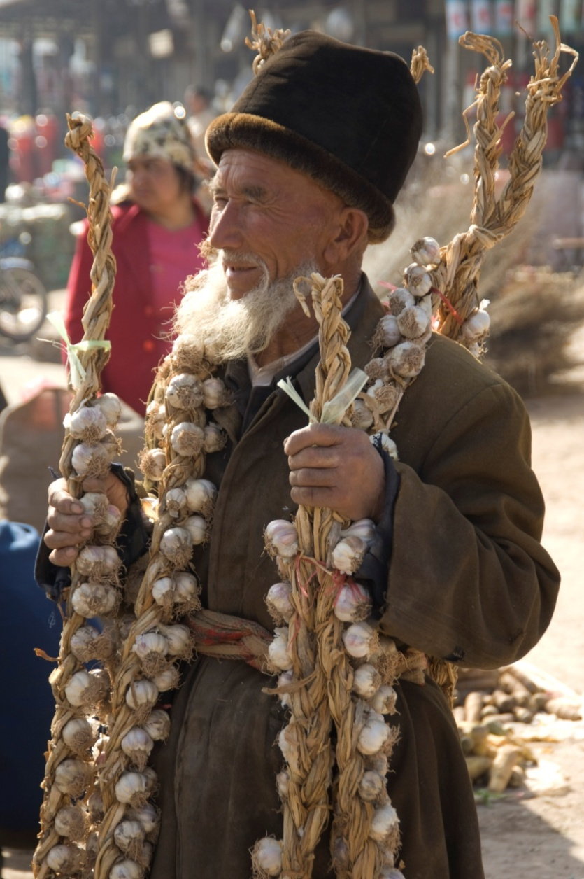
Gollings images
© John Gollings

Slide 12
Australian National Data Service
$72.5 million Government intervention
“Managed, connected, discoverable, re-usable data”
Building the Australian Research Data Commons
Monash lead agency
50+ staff

Slide 13
Monash University Publishing
Electronic publishing
Open access monographs
2012 target: 25 titles
Two journals
Print on demand
Short print runs
Content generated by faculty editorial committees

Slide 14
Research skills development
Research skills development
Information literacy +
learning skills
Information literacy
A ten year journey
User education

Slide 15
Context and background
Monash University Library’s educational objectives
- to embed research and learning skills within faculty curricula
Monash University Graduate Attributes
- leveraging research and learning skills within curricula
“The development of students who are “critical and creative scholars who produce innovative solutions to problems; apply research skills to a range of challenges and who communicate perceptively and effectively.”
Research Skills Development (RSD) Framework (Willison & O’Reagan, 2007), is a crucial element in achieving these attributes
Notes:
Students learn best at the point of need
Placing research and learning skills within the content of the discipline – so that skills development is not divorced from content.

Slide 16
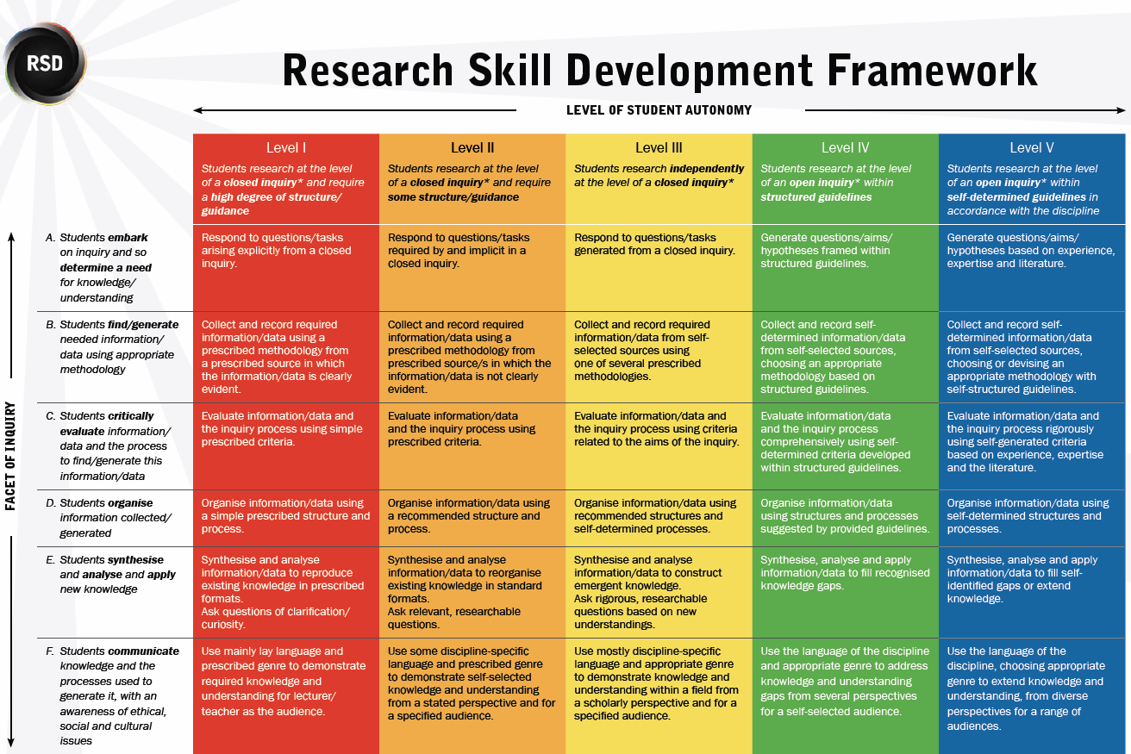
Notes:
Conversations around the placemat
I believe, and I imagine that I’m not alone here in saying - that the overarching challenge for the library is to be understood, to communicate and demystify what it is that we do and what Information literacy means, and how we can contribute meaningfully to student learning – so how an we communicate this in a way that makes sense?
In early 2009, I called the 3 academics from the Faculty of Business and Economics who were using the RSD at Monash and contributing to John’s ALTC research.
We organised a meeting - our first conversation around the placemat, and what we discovered through our conversation, was that through a mutually understood language, articulated through the RSD Framework, we were able to see ourselves on the same page.
The conversation around the RSD placemat offered us insights and understanding about the professional, pedagogic, and discipline based perspectives of our respective teaching practices, and the challenges of enabling collaboration and developing partnerships “across the divide” as organisational structures tend to pull us apart rather than bring us together.
This meeting sparked the beginning of a shared interest in exploring the collaborative potential of the RSD Framework between librarians, learning skills advisers and discipline based academics– to improve student learning through the acquisition of research skills.
After this meeting, Sue Mayson, Glen Croy, Jan, Schapper from BUS Eco and Leanne McCann, learning Skills Manager and myself commenced planning our first RSD workshop.

Slide 17
Managing change
Extensive professional development
Peer to peer
DARE: a five year program
Managing change
Project management
Appointment of leaders/change agents
Notes:
Collections
Datasets
The ARROW Repository is experimenting with the storage and publication of instrument datasets to support conventional research publications. The first dataset published is
2QP2 - Structure of a MACPF/Perforin-like protein. (http://arrow.monash.edu.au/hdl/1959.1/5863)
Information on experimental dataset object “monash:5863”
Dataset consists of 5 experiments on Protein 2QP2 and this generated approximately 36 GB of raw machine data which was compressed down to 11 GB and broken up into 8 “tarballs”.
File extraction requires familiarity with gzip and tar formats and tools.
The fedora object stores:
8 external reference datastreams
URL references to tar.bz tarballs stored outside the repository.
6 content datastreams
5 instrument data files
One PDF extraction instructions.
1 DC metadata datastream.
There is no community specific metadata schema associated with this test file. The DC was derived by hand and it’s not representative of a final solution.
The dataset is supplementary content for the article published in http://www.sciencemag.org/cgi/content/abstract/1144706
The handle to object monash:5863 is published in note 32 of the full text for the article.
Important to note that ARROW does not play a role in the use or interpretation of the data.
The extracted files are raw instrument data and require an understanding of crystallography specific instrument data and software tools to use. The images generated as part of the published scientific papers are most alluring. People collect the images! See the next slide.

Slide 18
Monash University Publishing
http://www.publishing.monash.edu/
Monash Research Repository
http://arrow.monash.edu.au/vital/access/manager/Index
Research data management
http://www.researchdata.monash.edu/
ANDS
http://www.ands.org.au/

Slide 19
Thankyou
Questions?

